Slide 1


Modeling Mass Protest Adoption in Social Network Communities using Geometric Brownian Motion
Fang Jin, Rupinder Paul Khandpur, Nathan Self, Edward Dougherty, Sheng Guo, Feng Chen, B. Aditya Prakash, Naren Ramakrishnan
Notes:
Good afternoon, every one! I am Fang Jin, from the Discovery Analytics Center, Virginia Tech. The previous talk mentioned the forecasting capabilities of EMBERS. This talk is also part of EMBERS project, and our goal is to model the spread of protests in social networks.

Slide 2
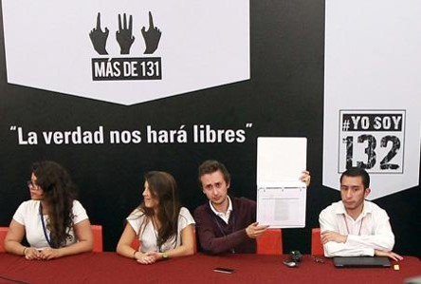
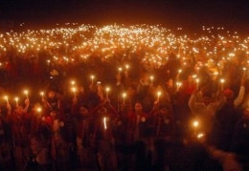
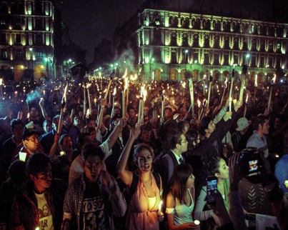
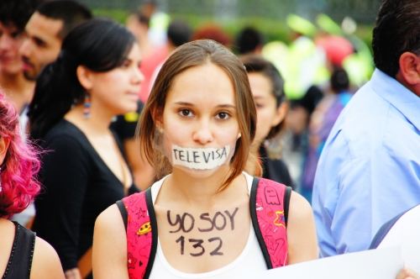
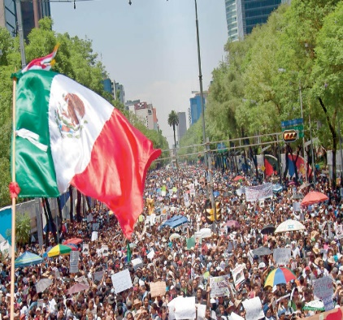
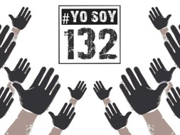

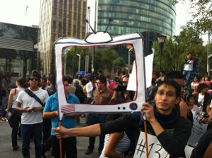

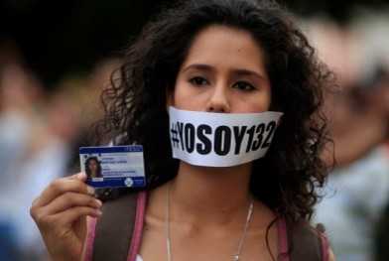
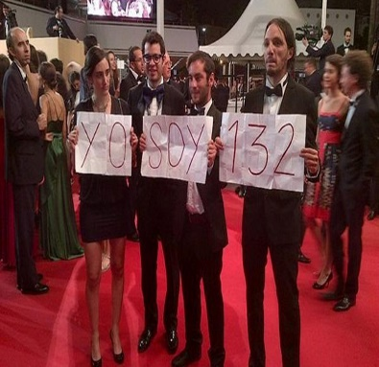
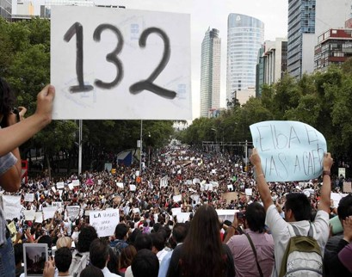
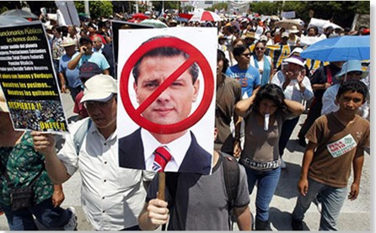
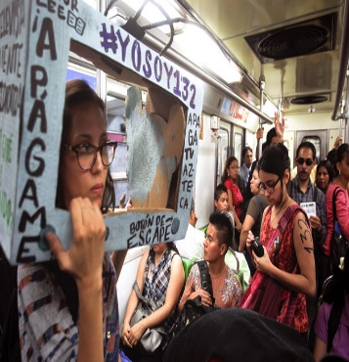
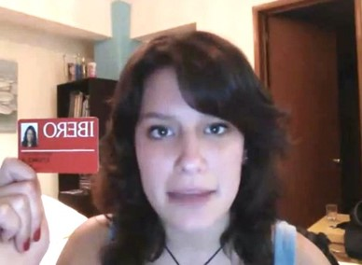
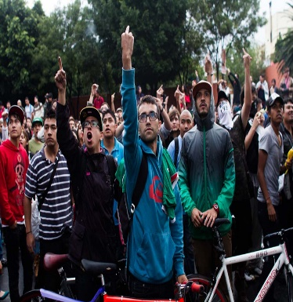
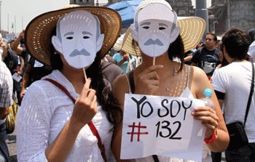
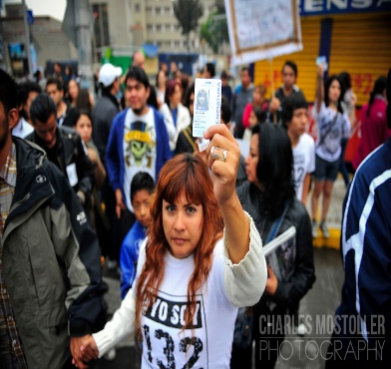
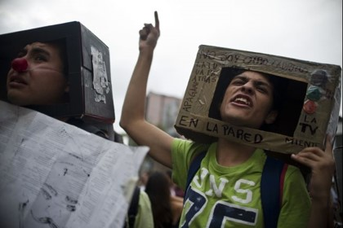
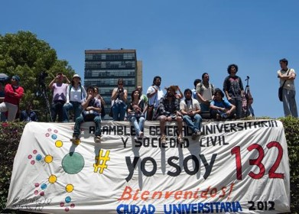
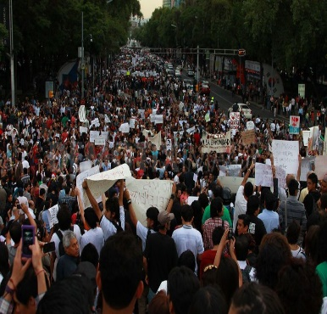
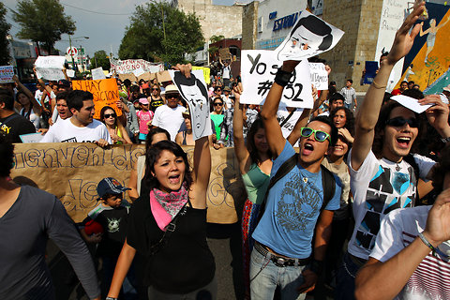
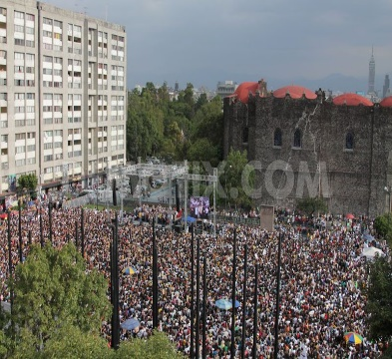
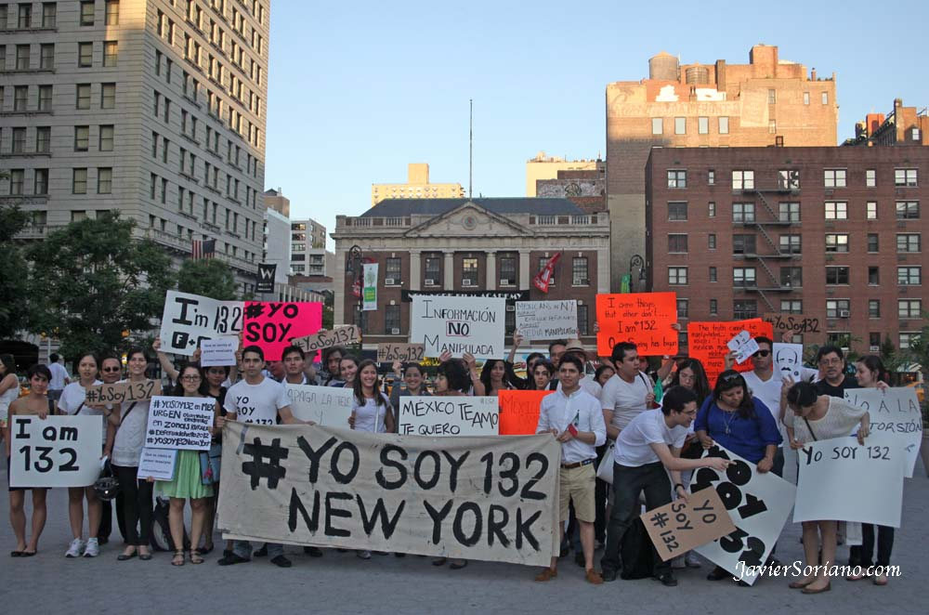
#Yosoy132 Protest
Business
Plan
Notes:
We know the social media are becoming more and more popular, not only in our daily life, but also in the protests and movements. Here is a social movement happened in Mexico, named Yosoy132, which started from a campus.
On May 11, 2012, the Mexican Presidential Candidate Pena, from (PRI party) visited the Ibero-American University, (a prestigious private university) to present his political platform to the students. At the end of his discussion, he was questioned by a group of students. After his statement, students chanted slogans for justice, running after him, and even throwing a shoe at him. Video of the event was uploaded by various students, but major Mexican television channels and national newspapers reported that the protest was not by students of the university, but by people who had been paid.
This angered many of the University students, prompting 131 of them to publish a video on social media, identifying themselves by their University student ID. The video went viral, and protests spread across various campuses. People showed their support of the 131 students' message by stating, mainly on Twitter, that they were the 132nd student—YoSoy 132, Spanish for "I Am 132", thus giving birth to the Yo Soy 132 movement.
The movement grew so quickly that by June 19 they were hosting a presidential debate with several of the main presidential candidates. Finally, they successfully request the government to have national broadcast for the presidential election.

Slide 3
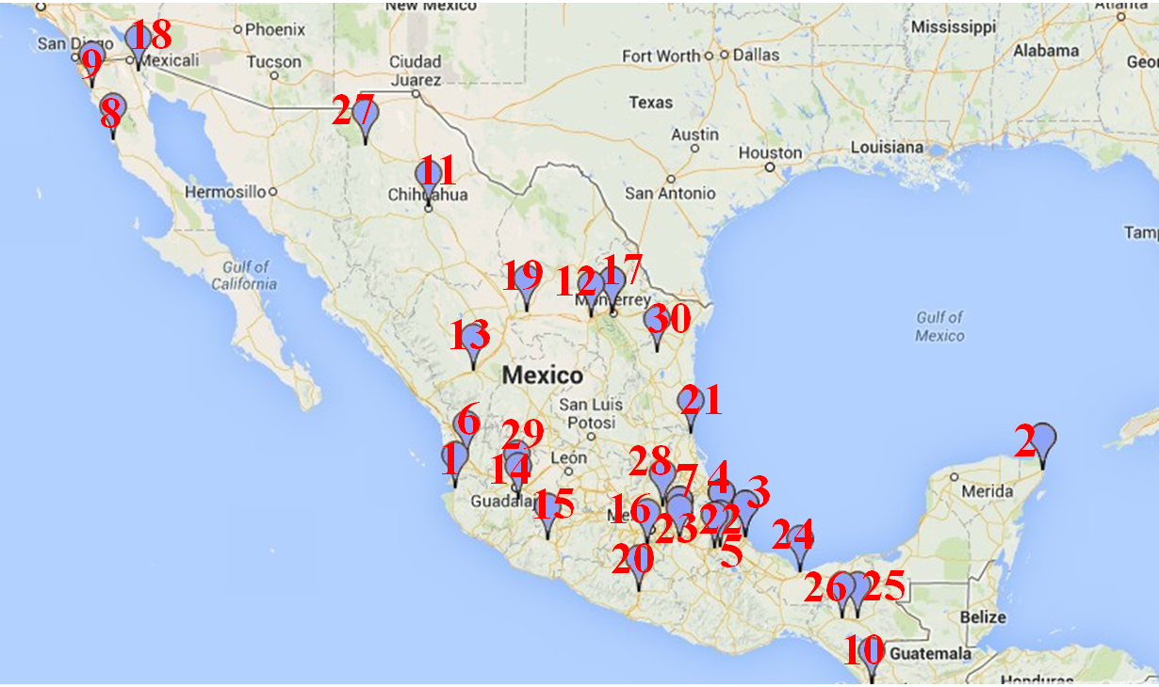
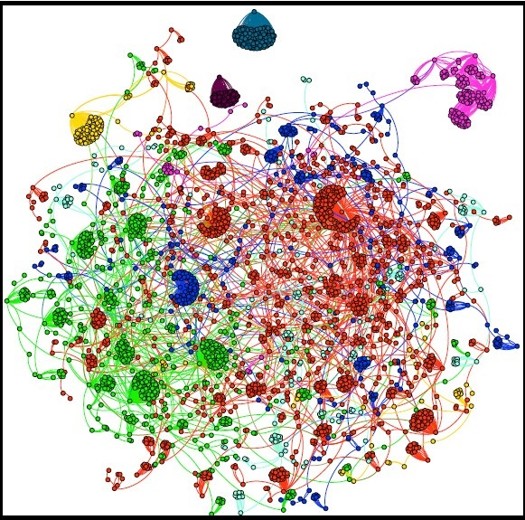
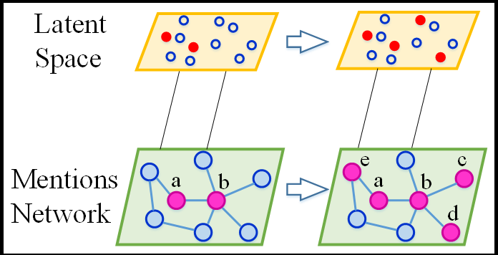
Motivation
Protest examples
Mass movement in Twitter
Propagation model
Goal:
Model the growth of protest participants within a social network.
Understand the underlying social network and structural dynamics.
Notes:
Even though YoSoy132 started with a campus protest, the movement spread all over the world of Twitter, YouTube and Facebook.
We are wondering, about this movement, one of the most striking things is, how its message linked groups that are traditionally disconnected: both across class and political affiliation? Can we find a pattern which can model the growth of protest within a social network? Can we develop a model incorporate the offline and online propagation?

Slide 4





Approach: Bispace model
Latent Space
We consider the mentions network to be stable
Mentions network
#YoSoy132
movement
"#megamarch
(transparent,
election)
(SEED QUERY)
Protest,
march,
demonstration …
#yosoy13
# granmarcha132
Notes:
We know it is hard to build a complete, exhaustive network of interactions, since there are friends network, retweets network, mentions network, also some unobserved outlets like world of mouth, newspaper, and so on.
So we propose bispace diffusion: the observed mention network and the latent space. Within the mentions network, users have either mentioned someone, or have been mentioned by someone, which means they have edges. The latent space refers to any interactions outside of mentions network. In the latent space, nodes neither mention anyone nor been mentioned by anyone.
For the propagation process, we think there are only two ways to communicate. One is by mentions network, the other is by latent space. In the latent space, nodes may be influenced by word of mouth, or newspapers, and so on. In the mentions network, nodes are influenced by the mentions network. We consider the mentions network to be stable.
For the two space, each space has its own propagation model. We use Poisson distribution to describe information propagation in the latent space. In the mentions network, we use geometric Brownian model.

Slide 5
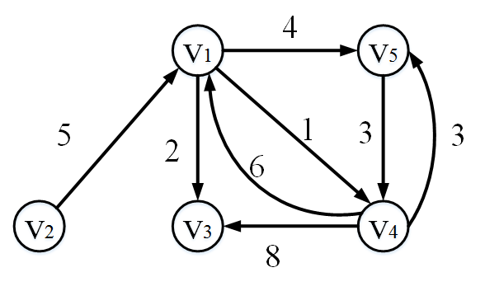
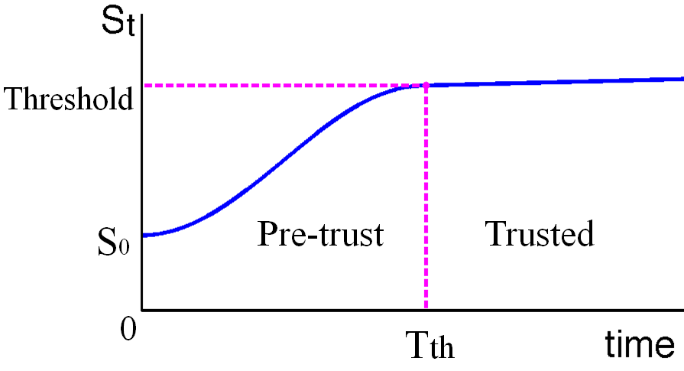
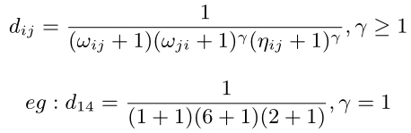
Geometric Brownian motion (GBM)
Brownian distance
Trust function
We define v^{j} trust function with v^{i} at time t as S_{t}^{ij}
We modeled the trust function S_{t} as a GBM process: S_{t}^{ij} ~ GBM
We define the Brownian distance, which depends on the mention frequency and number of common direct neighbors
Brownian distance is a measurement of the closeness and diffusion possibility of the nodes
Infection condition:
ln (S_{t}^{ij} ) >= d_{ij}
Notes:
So how the geometric Brwonian motion model applied in protest propagation? First of all, we need to define a Brownian distance, for each two nodes, there is a Brownian distance. Since we suppose the mention network to be stable, so the Brownian distance is also fixed.
The Brownian distance, which depends on the mention frequency and number of common direct neighbors.
Next, we introduce the notion of a trust function S_{t} , which we use to model an individual user’s agreement with some topic. We divide the trust process into a pre-trust period and trusted period. In the pre-trust period, as a user receive new information, the user’s trust function S_{t}, increase exponentially until reach the trust threshold. For simplicity, an individual cannot revoke trust once this threshold has been crossed. We model the trust function S_{t} as a geometric brownian motion process.
The infection condition is, the ln(s^{ij}_{t}) should cross the Brownian distance d_{ij}

Slide 6
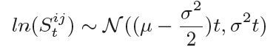
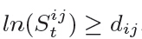
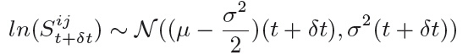
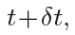
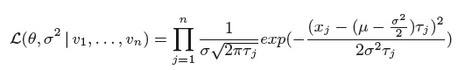
GBM propagation
At time t,
At time
GBM parameter estimation

Slide 7
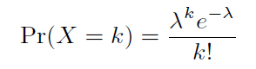
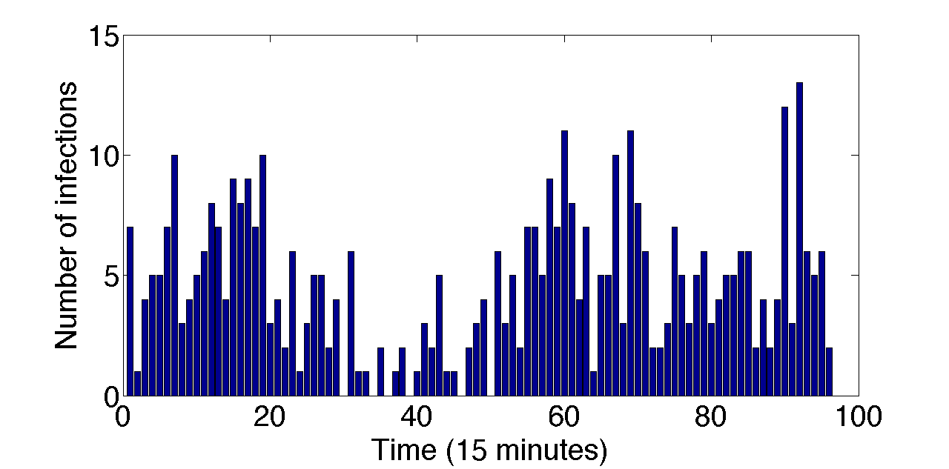
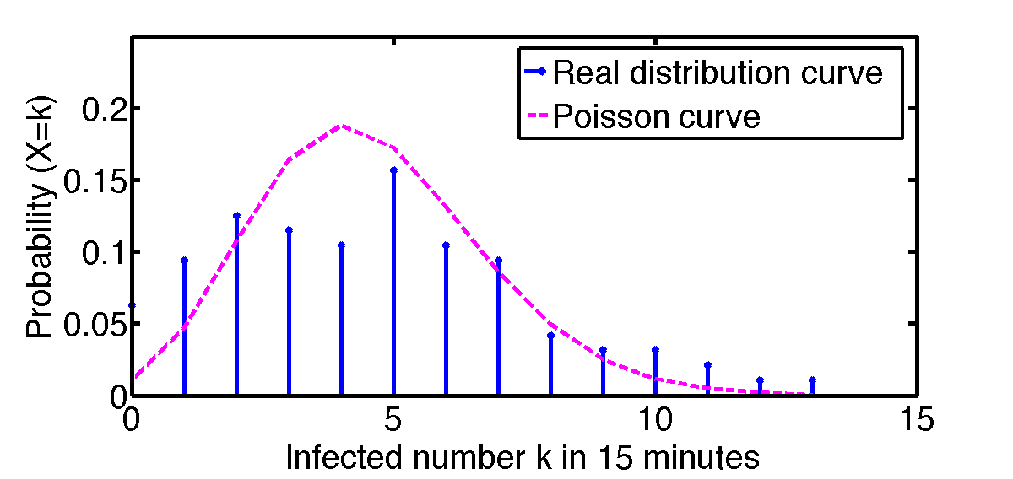

Latent space: Poisson model
We assume the probability of the number of newly infected users, X, in a given time interval satisfies the Poisson distribution:
#yosoy13
# granmarcha132
Infected nodes in latent space
Poisson distribution fit (λ = 4.18)
Notes:
In the latent space, we found the newly infected nodes number satisfied the Poisson distribution. We collected isolated nodes in latent space, like the left figure shows.
The right side, we can see, the truly propagation nodes number generally satisfy a Poisson distribution. (0=<k<=13)
Now, we have a complete bispace propagation model: one is GBM model within mentions network, the other is Poisson distribution in the latent space.

Slide 8
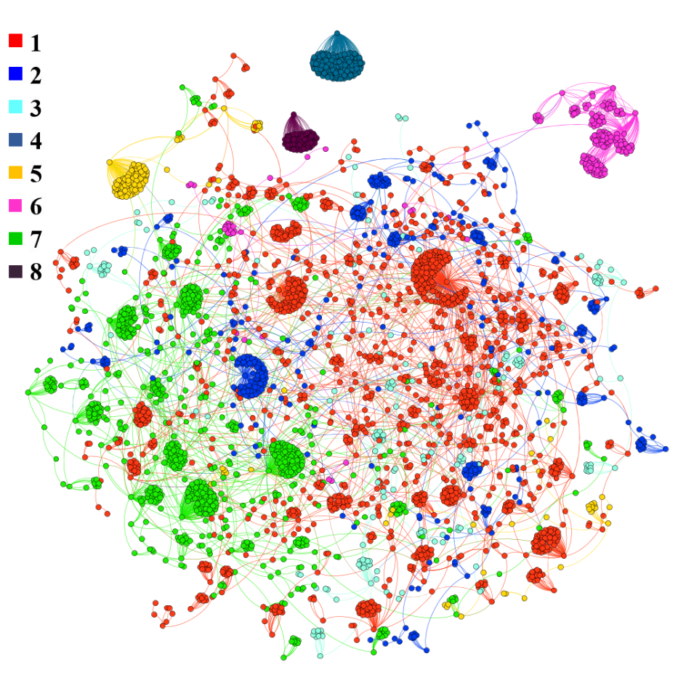
GBM with community
Assumptions:
Each community has its own parameter
If v_{i} and v_{j} are in the same community c_{i}, the propagation will follow c_{i} parameters.
Propagation from one community to another happens as per the source community's model parameters.

Slide 9
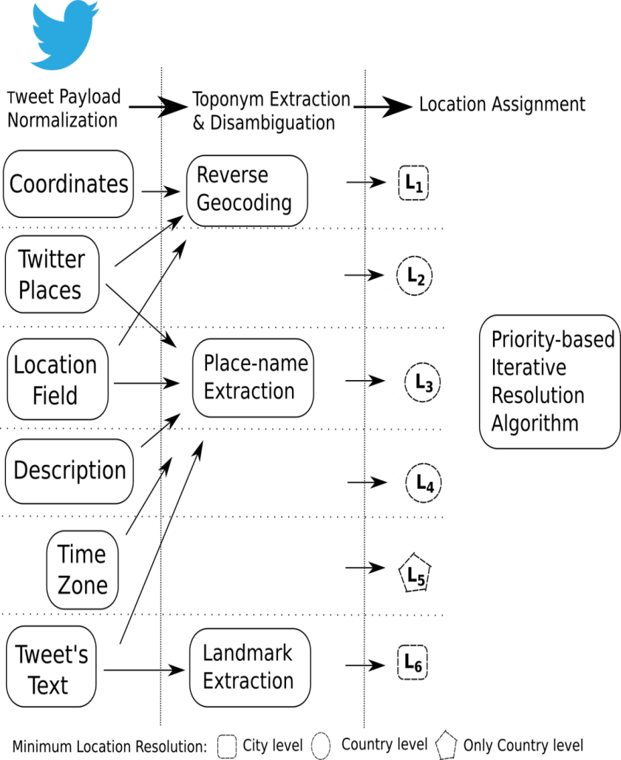
Data description
GSR
hashtags
Filtering
Geocoding
Infected nodes
Filter tweets by hashtags like “#LaMarchaYoSoy132, #ReformaEducativa”
Geocoding the filtered tweets by content and properties of its users
We extract and geolocate 20227830 users, assuming they are infected users
Gold standard report (GSR) contains: location, date, type of protest, url
For prominent protests, GSR has hashtags
Given one day and one country, get the mentions network
Initial mentions network
Geocoding process
Notes:
We have a gold standard report including all the protests in South American from 2011, so all the experiments are conducted on South American Twitter.
Hashtags, infected nodes, Geocoding, initial mention network.

Slide 10
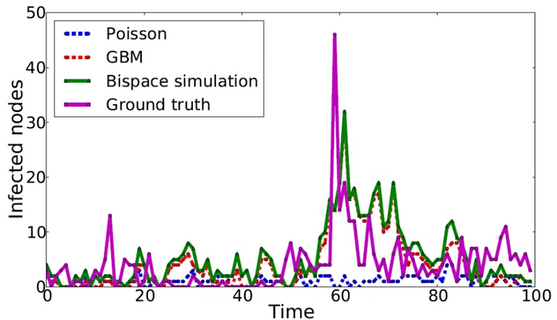
Simulation Result
Bispace simulation value = Poisson value + GBM value
Notes:
Here we plot the simulation results of four curves, the bispace simulation result is the sum of passion value and GBM value. The pink curve is the Ground truth, and the green curve is the simulation result. We can see our bispace simulation result is effective at capturing the propagation rate. It can simulate the burst time, even though not exactly right time moment.

Slide 11
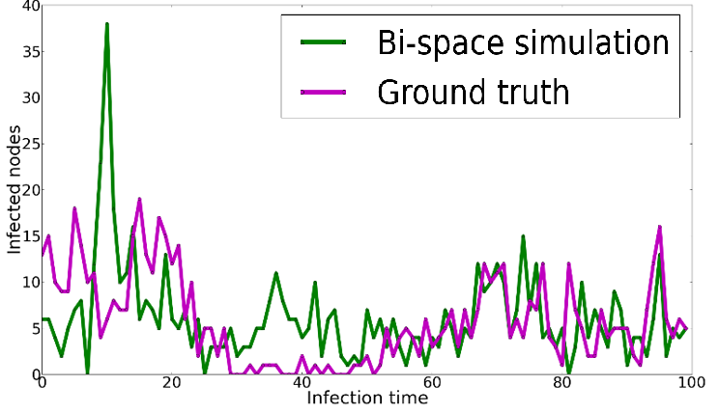
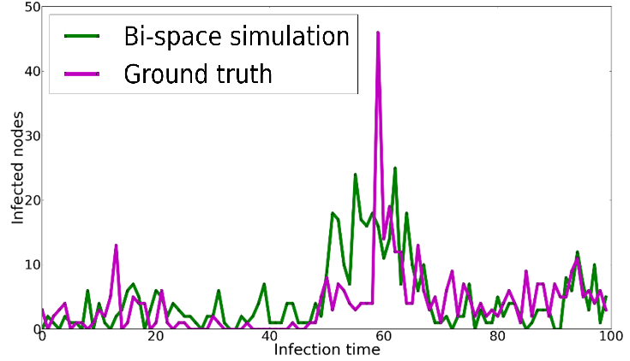
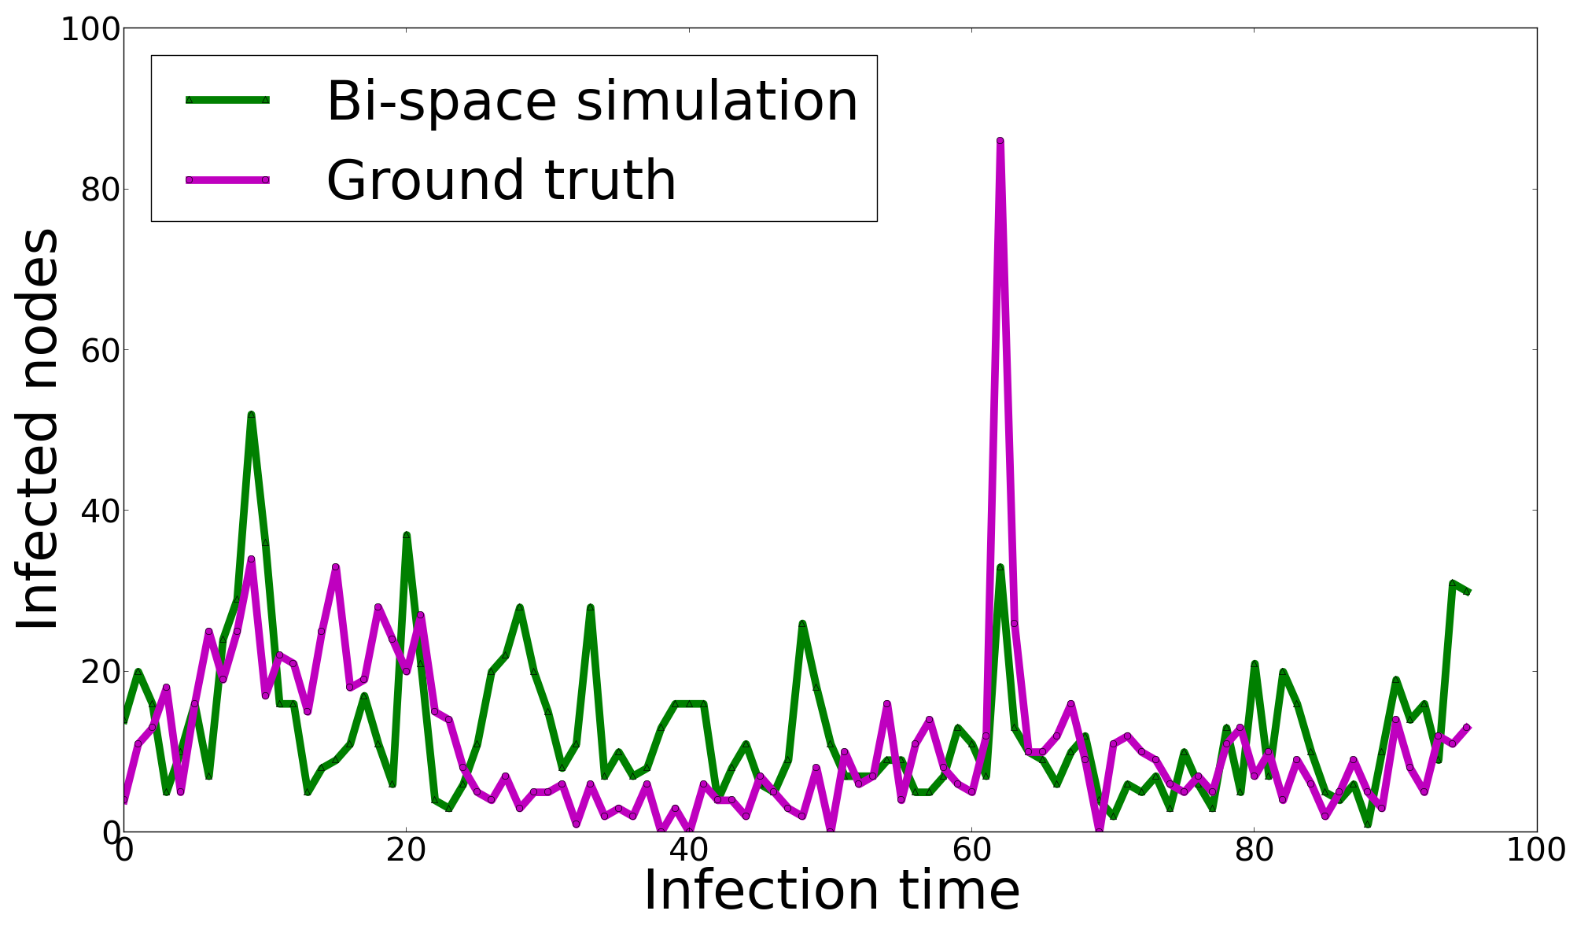
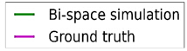
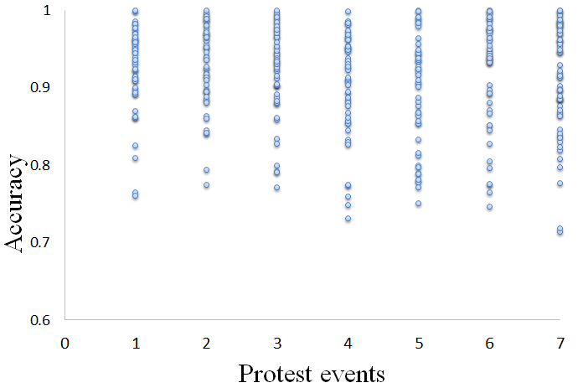
Simulation results for more cases
Mexican Yosoy132 protest
Colombian anti-government protest
Mexican teachers’ protest
Accuracy for 7 protest events
Notes:
We did 500 times experiments, here we plot the examples of accuracy range. Basicly, the average accuracy is 0.90.
Look at the Mexico Yosoy132 protest, we see the green curve is our simulation results, and the purple color is the ground truth. We can see the bispace model is able to capture many mass protest scenarios, to the order of magnitude. Even though it cannot simulate the propagation speed accurately at every time point, the method is effective at capturing the total number of infected nodes.
We also see the same quality on other protest, here we show the Colombia anti-government protest and Mexico Yosoy132 movement.
The Colombia anti-government movement happens on December 5, 2012, in every street every city of Colombia. People call to protest against the government on Twitter and facebook, and they make appointment to start the protest at 7PM local time.
The Mexico Yosoy132 protest started from university students on May 17, 2012, they claim the presidential election was a fraud on Twitter, and then move to the street to express their frustration.

Slide 12
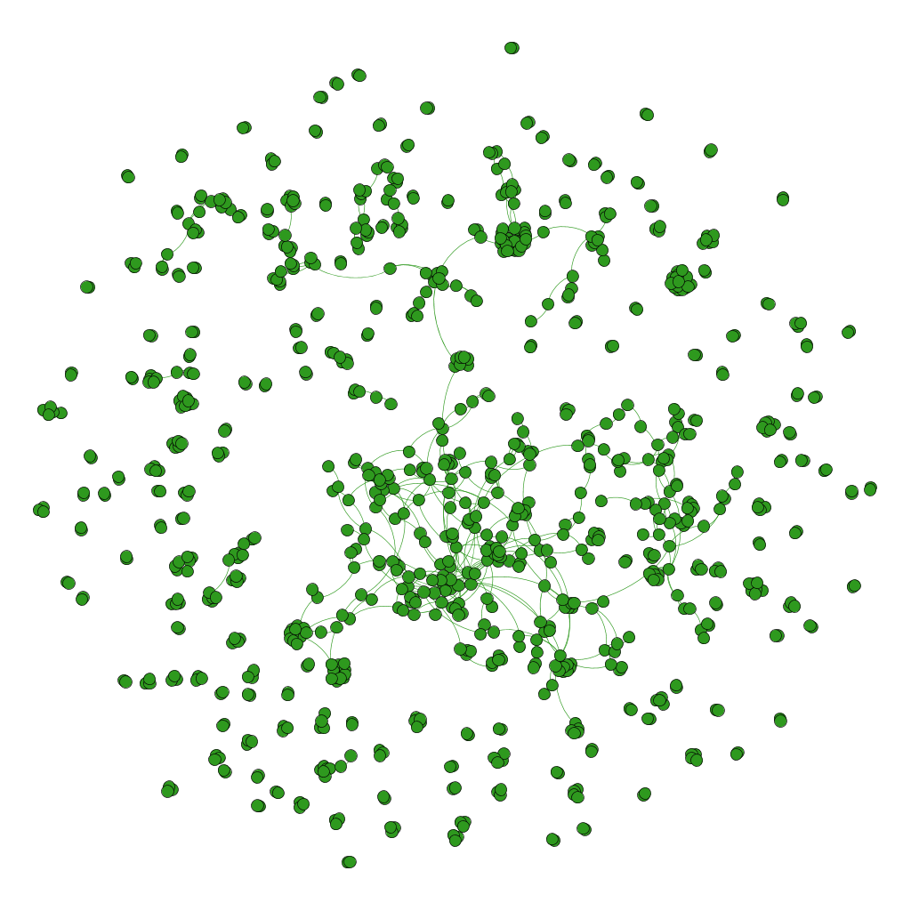
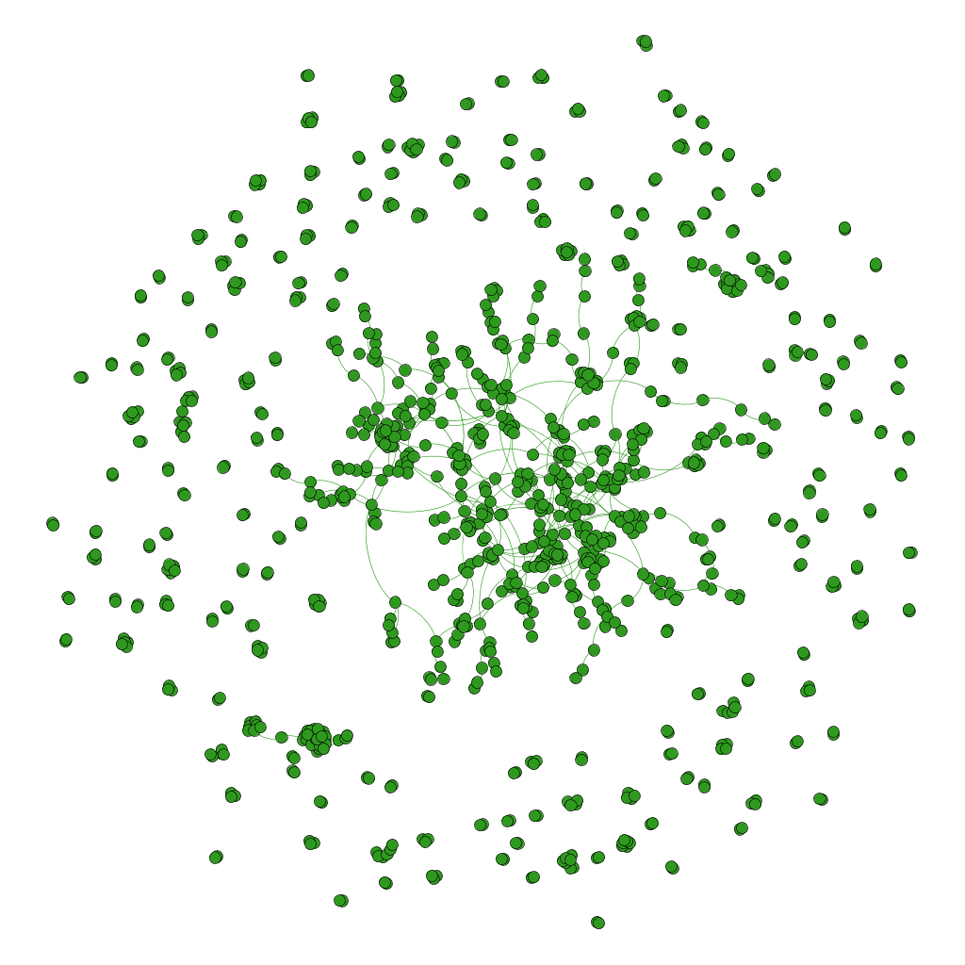
Subgraph structure evaluation
Simulated infection subgraph
True infection subgraph
 | Average degree | Diameter | Graph density | Connected components | Average clustering coefficient | Average path length
Simulation | 1.791 | 11 | 0.002 | 183 | 0.083 | 4.786
Ground truth | 1.726 | 18 | 0.002 | 204 | 0.008 | 6.261
GBM simulation results for teacher protest events on Sep 2, 2013
Notes:
Besides of comparing the simulation time curves, we also want to see if we can simulate the network structure.
We just show one example here, the Mexico teachers’ protest simulation network, the left is the simulated infection network, the right one is the truly infected network, how close they are?
Let us look at this table. By comparing the network parameters of simulation and ground truth, we found, the most parameters, like average degree, diameter, graph density, connected components and average path length are well fitted, only the average clustering coefficient does not match, which shows the GBM tends to infect nodes locally. There must be some additional information should consider. This is also one limitation of our model design.
(like even nodes within mention network, can be influenced by latent space. )

Slide 13
Conclusion
The bispace model is effective at capturing the total number of infected nodes. We run 500 times experiments, the average accuracy is 0.90.
The GBM model can simulate the protest burst, even though not at the precise moment.
In the bispace propagation model, the GBM process is more influential than the Poisson process.
The GBM model performs well for these network structure metrics: average degree, diameter, graph density, connected components and average path length
Capturing the average clustering coefficient needs improvement.

Slide 14
Thanks! Fang Jin: jfang8@cs.vt.edu

